Slide 1
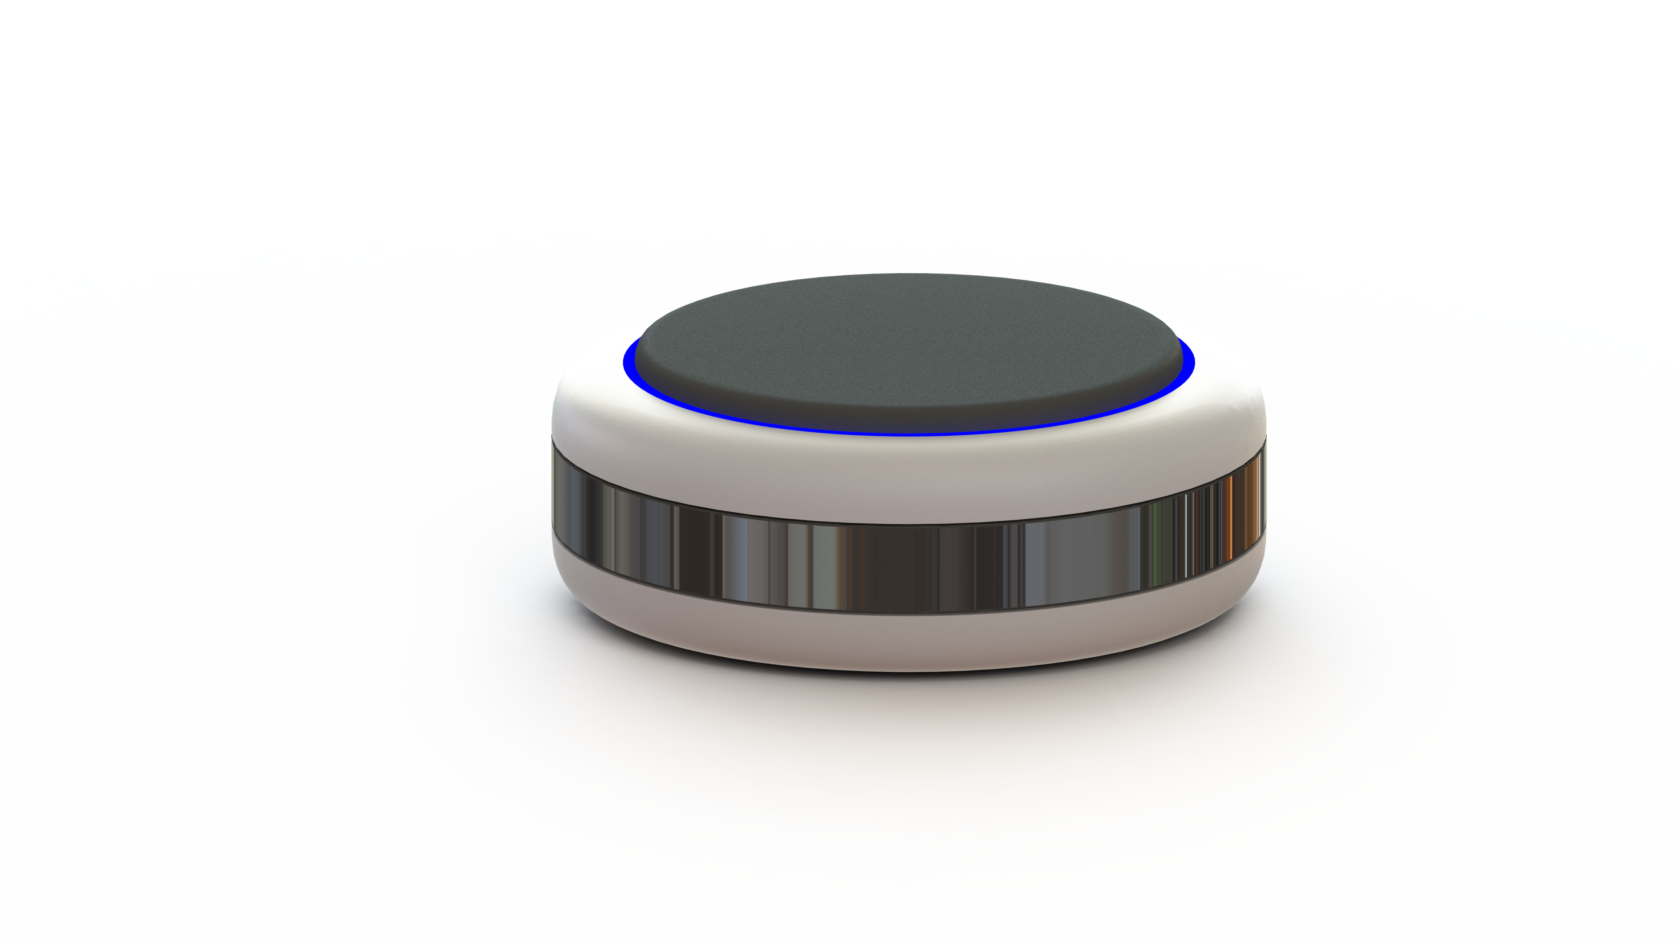
Heartbeat Engine
Haptic
Heartbeat
Rubber Damper
LED Indicator
Capacitive Touch

Slide 2
Programmable Heartbeat Patterns
Crisp & Realistic: Advanced Linear Resonance Haptics
Low Production Cost of ~$15
Multitude of Products with One Device
Wearable Sleep & Wake Assistant
for Grown-Ups
Bed-Mounted Sleep Inducer
for Babies
Plush Toy with realistic heartbeat

Slide 3
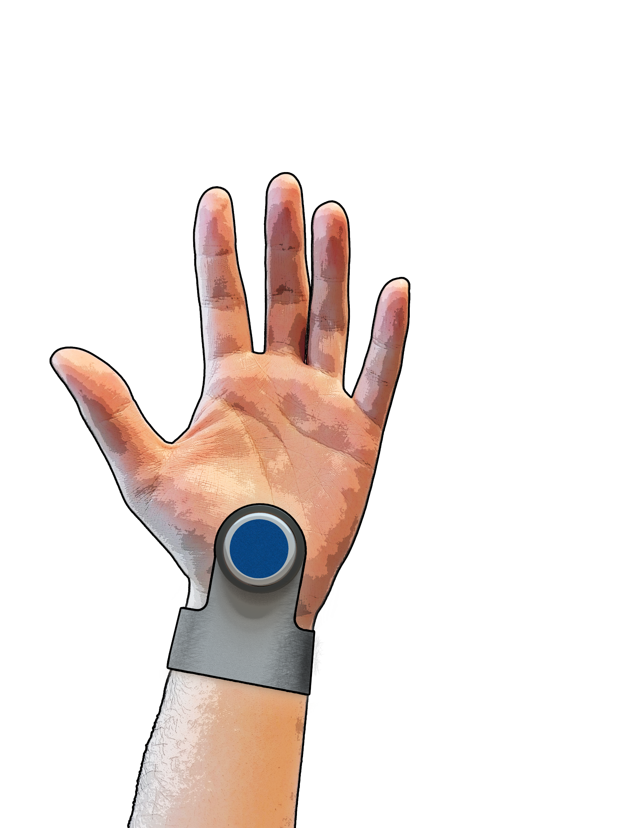




Wearable Sleep & Wake Assistant
for Grown-Ups
The Heartbeat Engine gently slows your heart rate, helping you fall asleep naturally at night.
It gently raises your heart rate each morning, giving you a natural energy boost—no more hitting snooze.
The gentle haptic taps on your wrist are precisely tuned to be silent, soothing, and undetectable by others.
Our HeartSync technology is rigorously tested and reliably effective—it simply works.

Slide 4
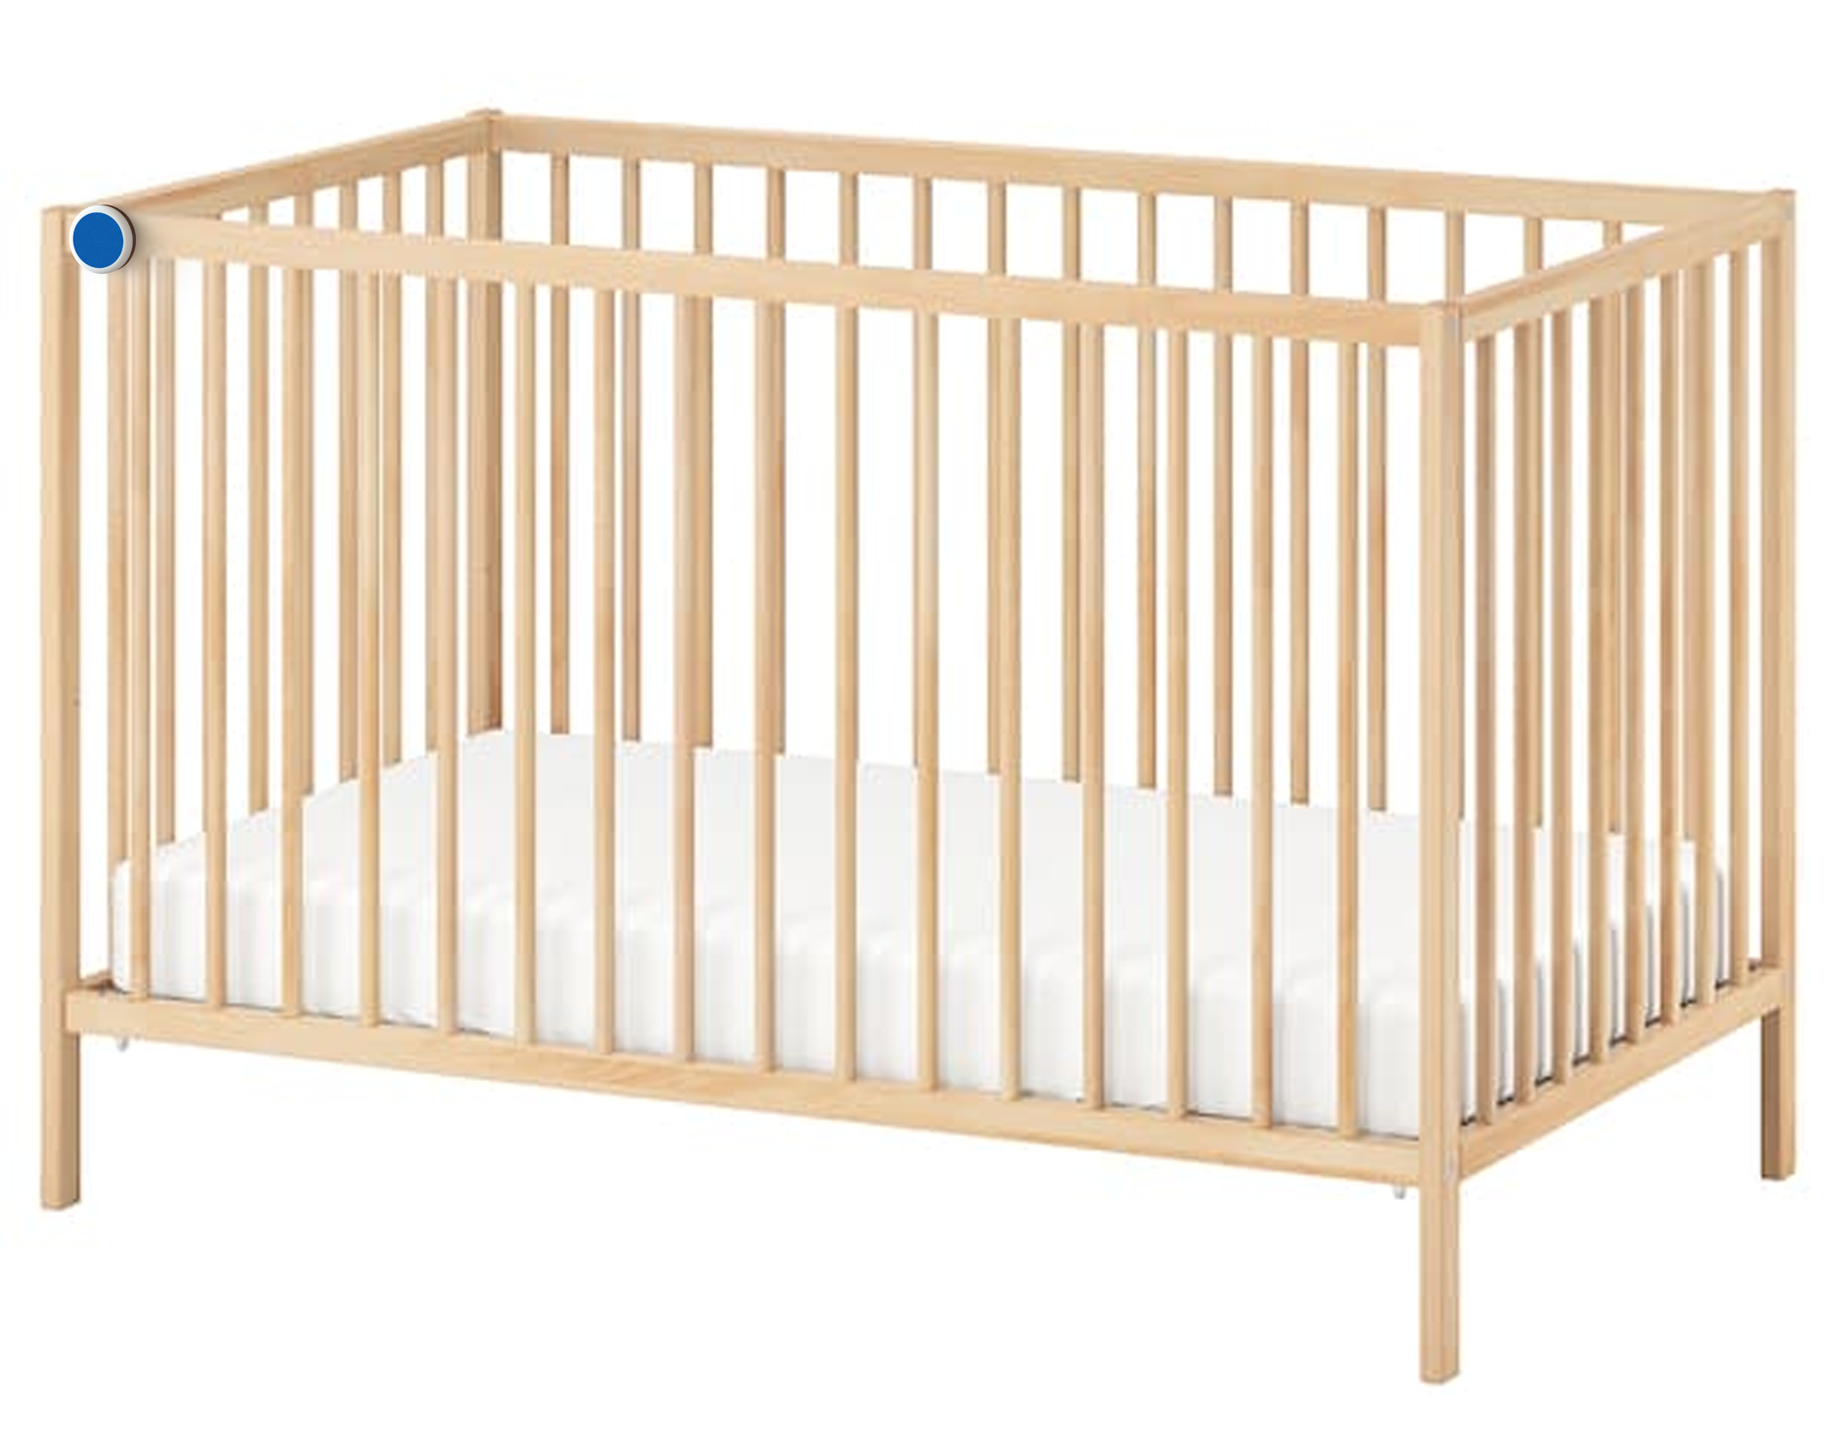

Bed-Mounted Sleep Inducer
for Babies
The Heartbeat Engine softly slows your baby’s heartbeat, helping them drift into natural, restful sleep—so you can finally say goodbye to sleepless nights.
Easily attaches to any baby cot, gently transmitting calming heartbeats through the mattress.
Our HeartSync technology is rigorously tested and reliably effective—it simply works.

Slide 5
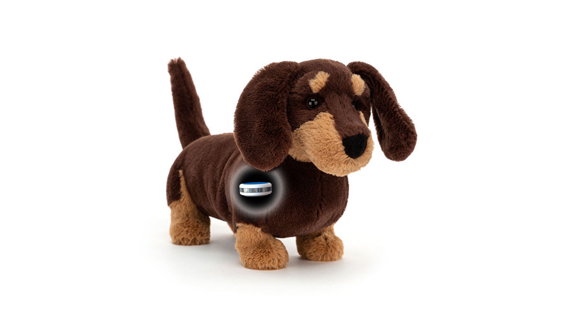


Plush Toy with realistic heartbeat
Our Heartbeat Engine gives plush toys realistic heartbeats—not artificial sounds from loudspeakers, but gentle, rhythmic beats you and your child can truly feel.
Thanks to our precisely tuned HeartSync technology, cuddling the plushie gently lowers your heart rate, delivering proven calming effects.

